Slide 1
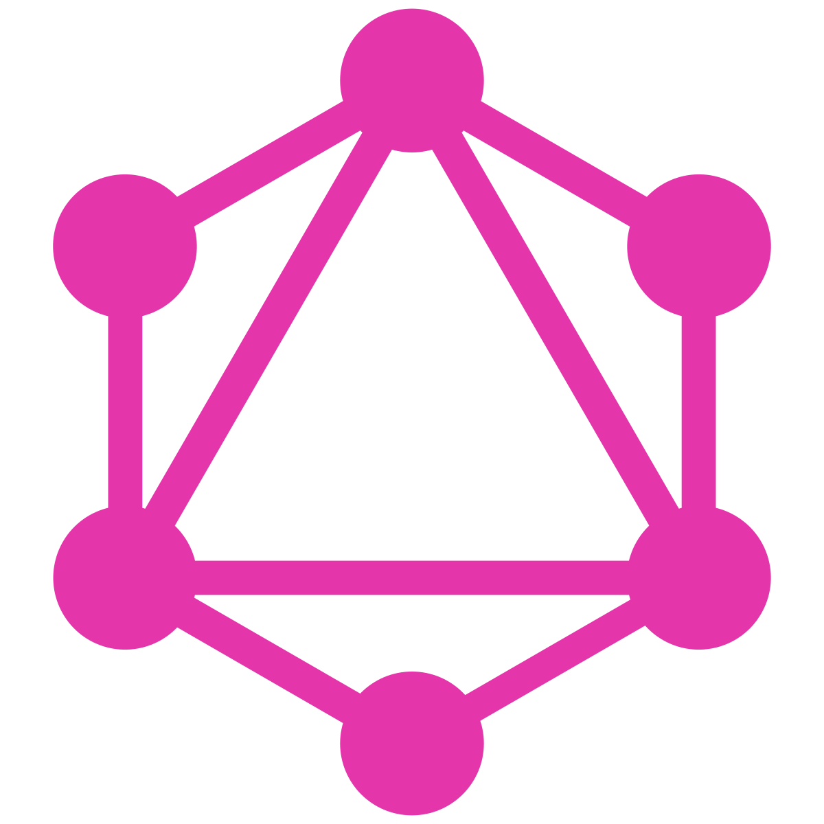
Presenter: Noufal Puthenpeedikayil
GRaphQL

Slide 2
CONTENTS
GraphQL - What and Why
Architecture
Application Components
Type System
Setup & Integrations
Practice

Slide 3
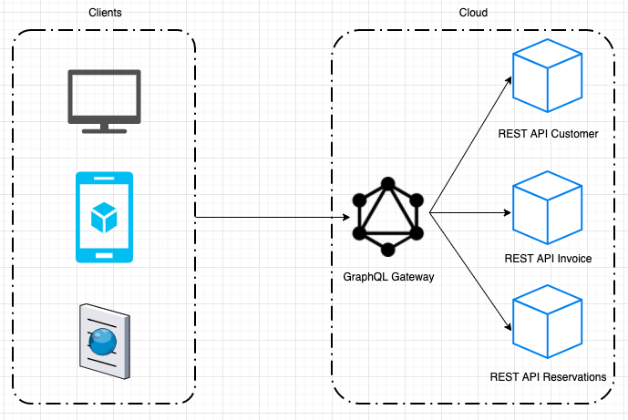
What is GRAPHQL?
Open-source server-side technology by Facebook to optimize RESTful API calls
It is an Execution Engine and Data Query Language
Faster and stable than RESTful services
Unlike RESTful services, while fetching from server, GraphQL can handpick specific data instead of complete fetch.

Slide 4
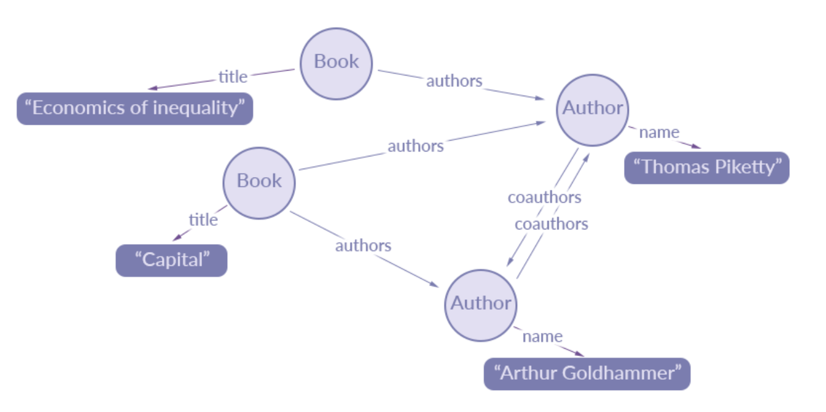
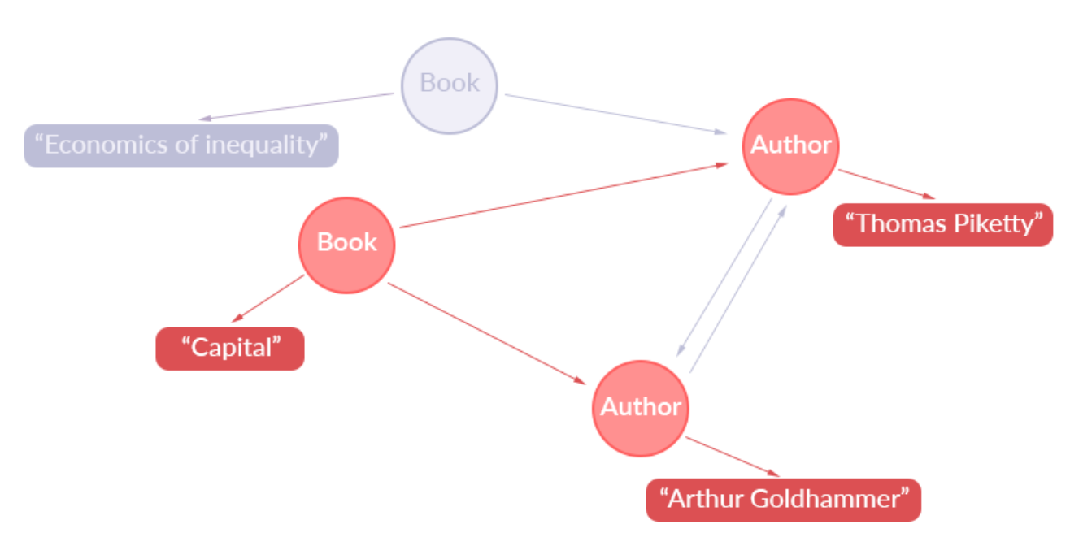
Why name GRAPHQL?
TRAVERSING => travel across / move back –forth – sideways
Define the structure as main graphs and sub graphs
Graphical Query Language (GraphQL)

Slide 5
ILLUSTRATIVE EXAMPLE
Sorry.. Take all colors
Sure.. Here is RED and BLUE
Hey Server, I need colors RED and BLUE
Hey Server, I need colors RED and BLUE
Colors Object
RESTful Services
GRAPHQL
Serve to Client
Serve to Client

Slide 6
WHY
GRAPHQL?

Slide 7
HOW??
How GRAPHQL Works?
GraphQL works by sending operations to an endpoint. There are three types of operations:
queries
Mutations
subscriptions.
A query is sent through an HTTP POST call to retrieve data.
A mutation is also sent through a HTTP POST and is used to modify data.
A subscription uses WebSockets to receive events.
What are the other API Techniques that match with GraphQL?
RPC (Remote Procedure Call)
REST (Representational State Transfer)

Slide 8
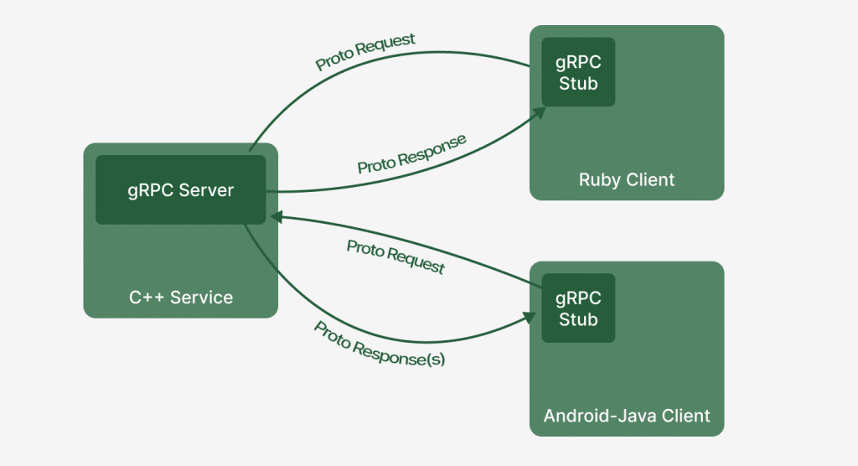
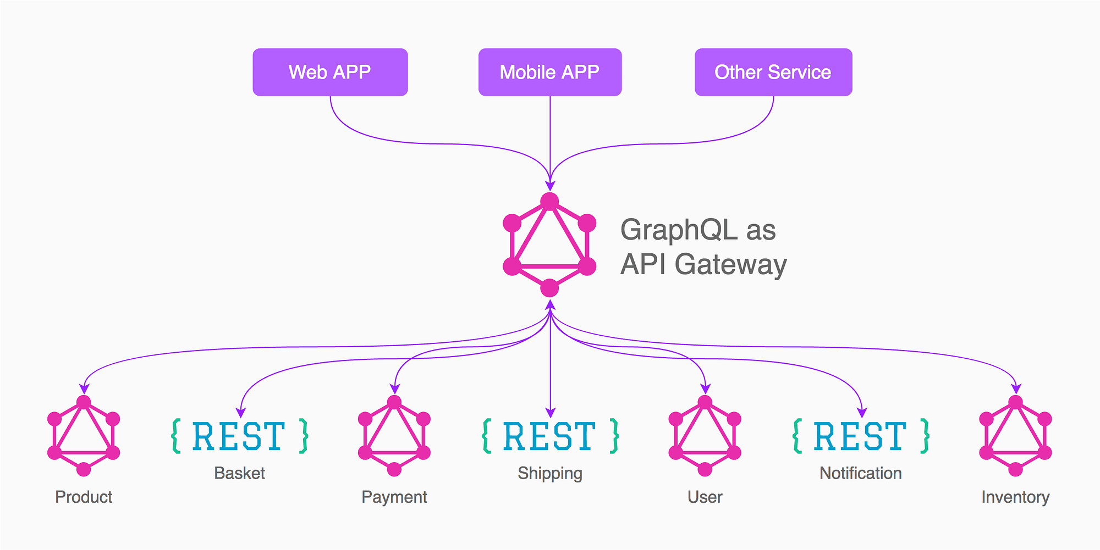
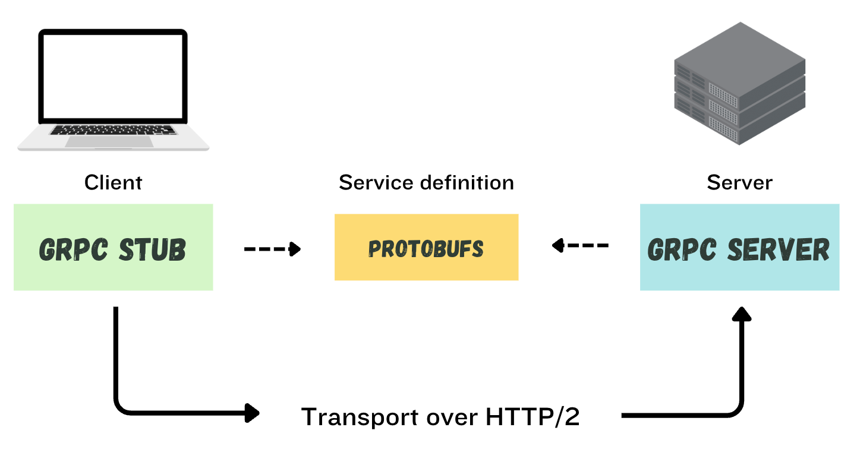
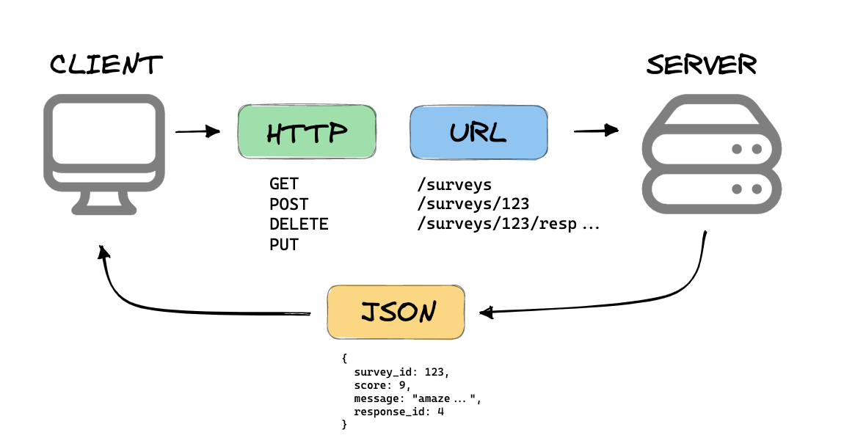
Difference RPC & REST & GRAPHQL
GRAPHQL
RPC
RPC
REST

Slide 9
Difference RPC & REST & GRAPHQL
RPC
“Remote Procedure Call”
One of the API design Technology by Google
the client communicates with the server by calling its methods as if they were local by creating a stub (client) with the same methods as the RPC server. You then use the client to call the server methods.
exchange data using Protobuf (Protocol buffers => mechanism that serializes structured data into binary format), compared to GraphQL, which uses text-based JSON to exchange data
Uses both http and http/2 methods
REST
“Representational State Transfer”
One of the API design Technology (most popular)
resources are identified by URIs (Uniform Resource Identifiers), and operations are performed on those resources using a standard set of HTTP methods
Uses only http methods
Resources are represented in JSON or XM
GRAPHQL
One of the API design Technology by facebook
Queries are used to request data from the server
Mutations are used to modify the data on the server
Subscriptions are used to get live updates when data changes

Slide 10
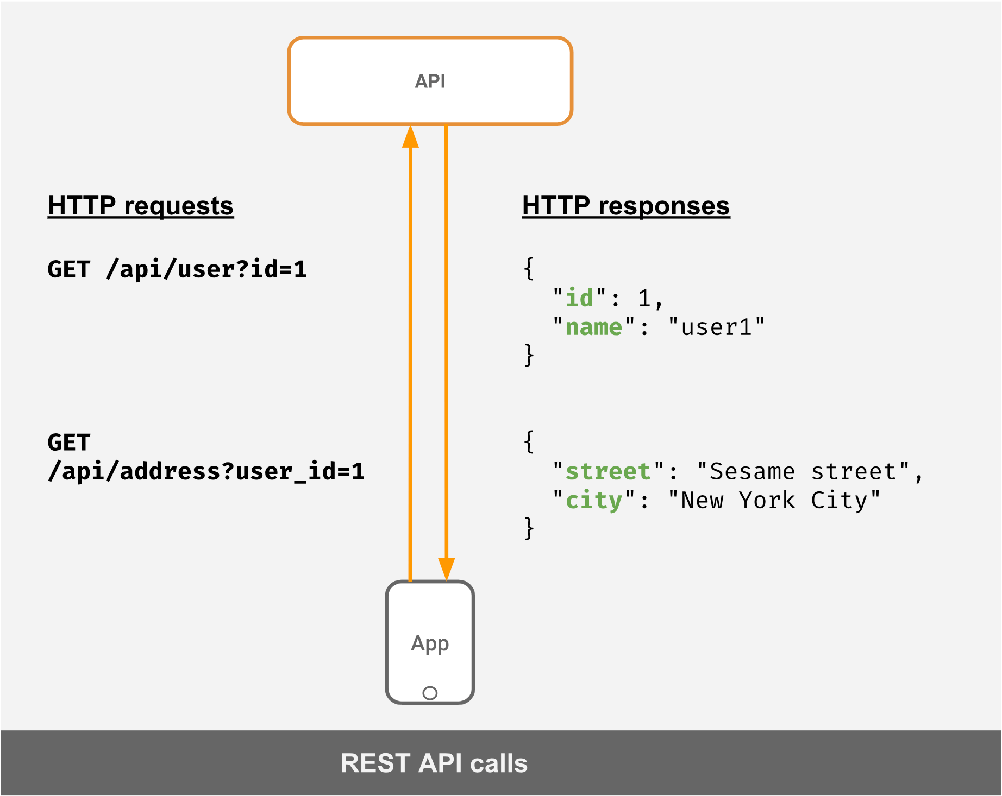
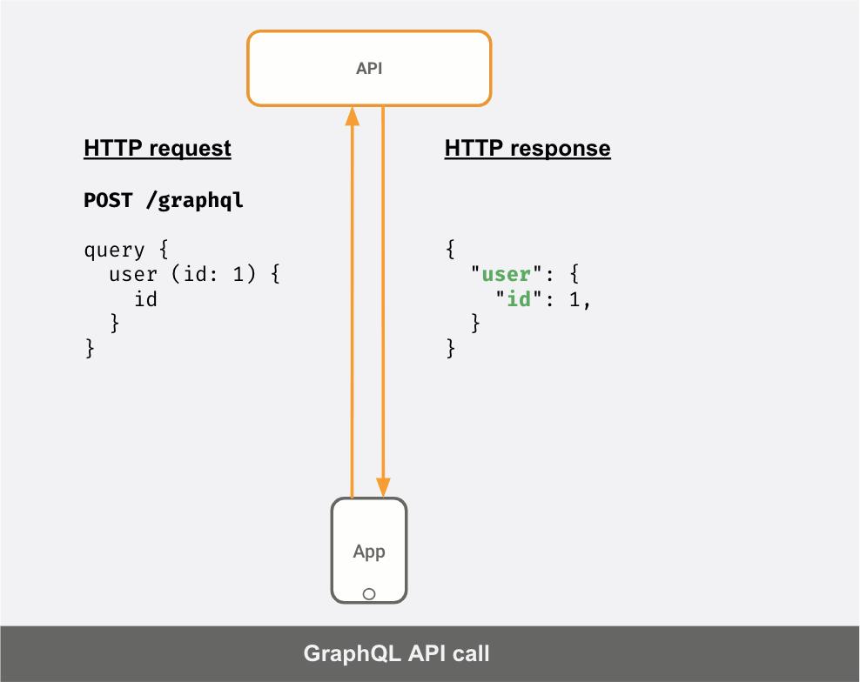
Difference
REST VS GrAPHQL

Slide 11
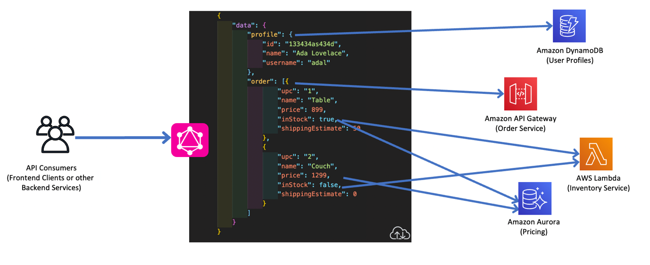
SOME USECASES of GRAPHQL
SCHEMA

Slide 12
Advantages of GRAPHQL
Avoid over-fetching: You avoid fetching more data than you need because you can specify the exact fields you need
Prevent multiple API calls: In case you need more data, you can also avoid making multiple calls to your API. In the case above, you don't need to make 2 API calls to fetch user and address separately
Less communication overhead with API developers: Sometimes to fetch the exact data you need, especially if you need to fetch more data and want to avoid multiple API calls, you will need to ask your API developers to build a new API. With GraphQL, your work is independent of the API team!
Self-documenting: Every GraphQL API conforms to a "schema" which is the graph data model and what kinds of queries a client can make.
Solves n+1 request problems

Slide 13
DISADVANTAGES
Overkill for small applications. Depending on your application needs, GraphQL may be overkill. Sometimes you just need a simple REST API with a small set of endpoints.
Performance issues with complex queries. GraphQL gives a lot of power to the clients. So, it’s necessary to add some protection in order to prevent the server from going down. Some practices to mitigate this risk include configuring timeout, maximum query depth, maximum query complexity.
Harder to integrate with monitoring tools. GraphQL returns 200 OK for errors, so it will be harder to integrate with monitoring tools.
Only JSON support. This may not really be an issue since JSON is the most used data format in APIs. However, if you need XML for example, GraphQL is not the right choice.
Lack of automatic HTTP caching mechanism. GraphQL uses a single endpoint with many different operations, so it’s not possible to use HTTP caching.

Slide 14
ARCHITECTURE

Slide 15
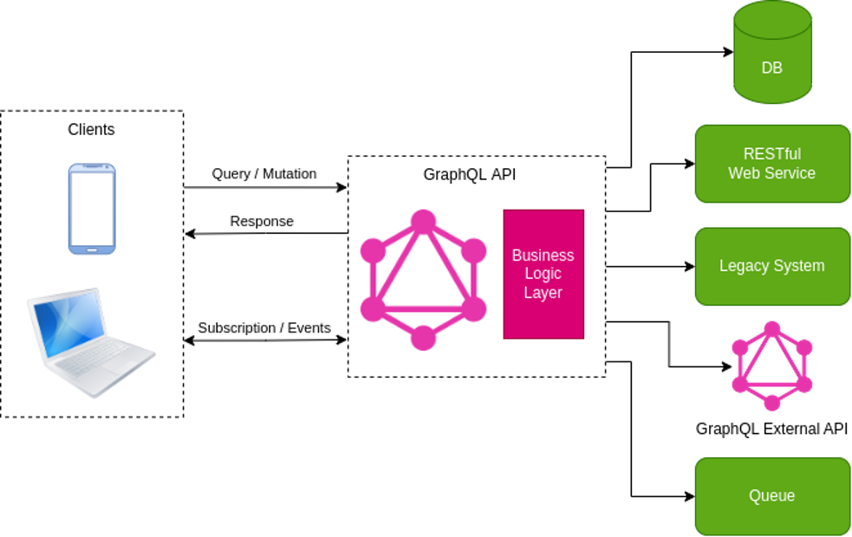
ARCHITECTURE DIAGRAM
GRAPHQL APPLICATION DIAGRAM

Slide 16
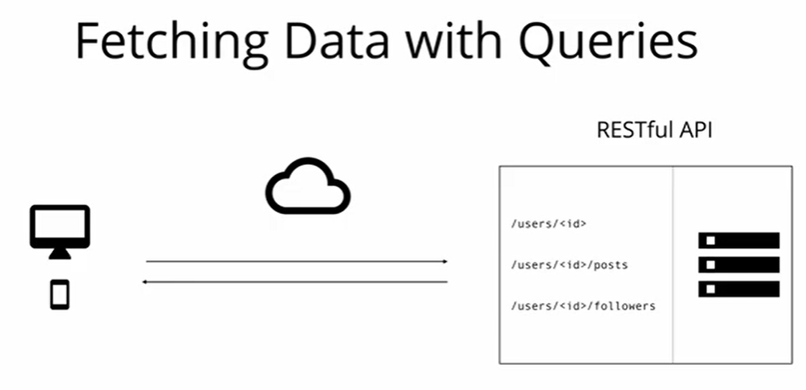
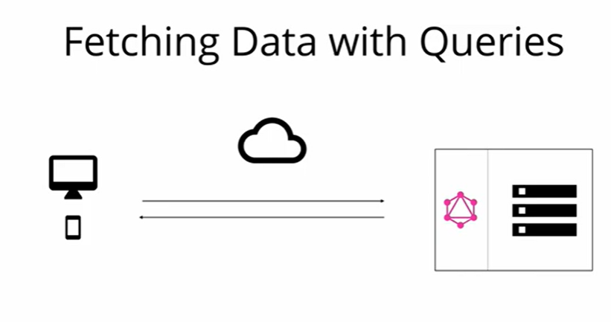
CORE CONCEPTS
REST and GRAPHQL working methods
REST API loads data from specific end points (multiple end points). Hence the returned data structure is clearly defined.
GraphQL Typically exposes only singe endpoint. The returned data structure is NOT defined. The client can decide what data is actually needed.
RESTful API Design
GraphQL Design

Slide 17
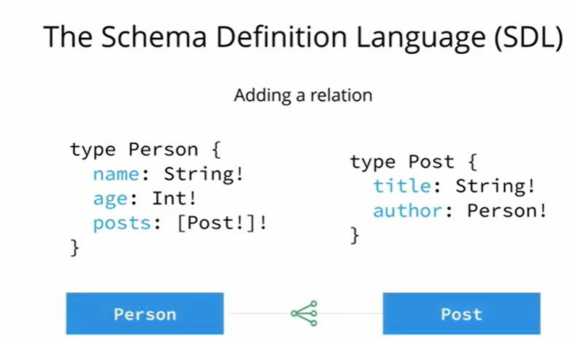
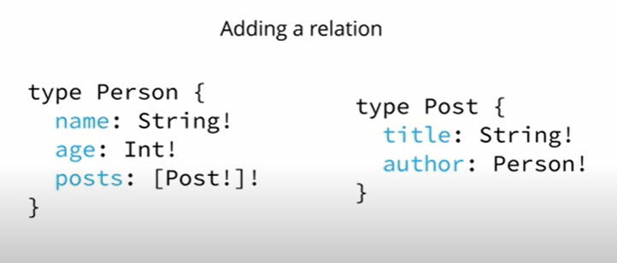
CORE CONCEPTS
SCHEMA DEFINITION LANGUAGE (SDL)
GraphQL has its own type system that’s used to define the schema of an API. The syntax for writing schemas is called Schema Definition Language (SDL).

Slide 18
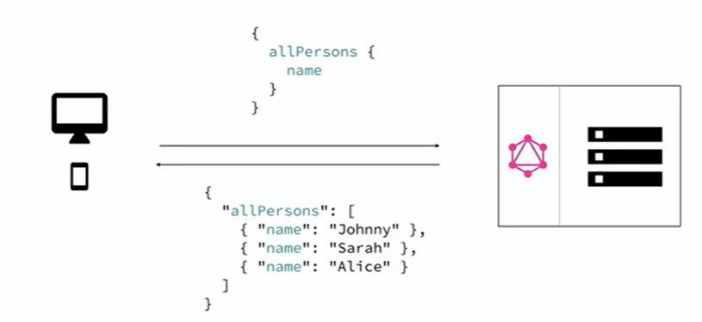
CORE CONCEPTS
How GRAPHQL process the request – response?
Payload
QUERY
GRAPHQL
REQUEST
CLIENT
RESPONSE

Slide 19
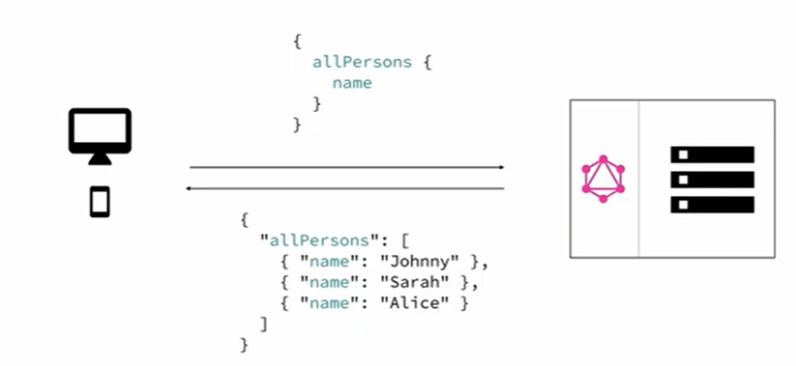
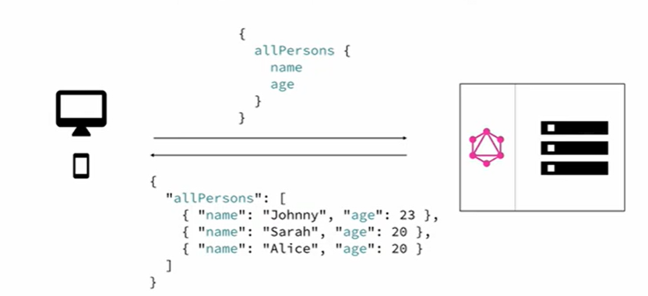
CORE CONCEPTS
FLEXIBLE QUERY SYSTEM

Slide 20
NEXT SESSION APPLICATION COMPONENTS TYPE SYSTEM

Slide 21
APPLICATION COMPONENTS

Slide 22
APPLICATION COMPONENTS
Different Application components in GraphQL.
1) Server-side Components
GraphQL server is the core component on the server side and it “allows to parse the queries coming from GraphQL client applications”.
Apollo Server is most commonly used implementation of GraphQL specification.
Other server programming components are:
Schema - A GraphQL schema is at the center of any GraphQL server implementation and describes the functionality available to the clients which connect to it.
Query - A GraphQL query is the client application request to retrieve data from database or legacy API’s.
Resolver - Resolvers provide the instructions for turning a GraphQL operation into data. They resolve the query to data by defining resolver functions.
2) Client-side Components
GraphiQL - Browser based interface for editing and testing GraphQL queries and mutations.
ApolloClient - Best tool to build GraphQL client applications. Integrates well with all javascript front-end.

Slide 23
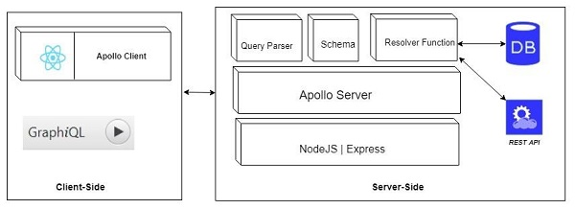
GRAPHQL APPLICATION STRUCTURE
Let’s understand what lies under CLIENT SIDE and SERVER SIDE..

Slide 24
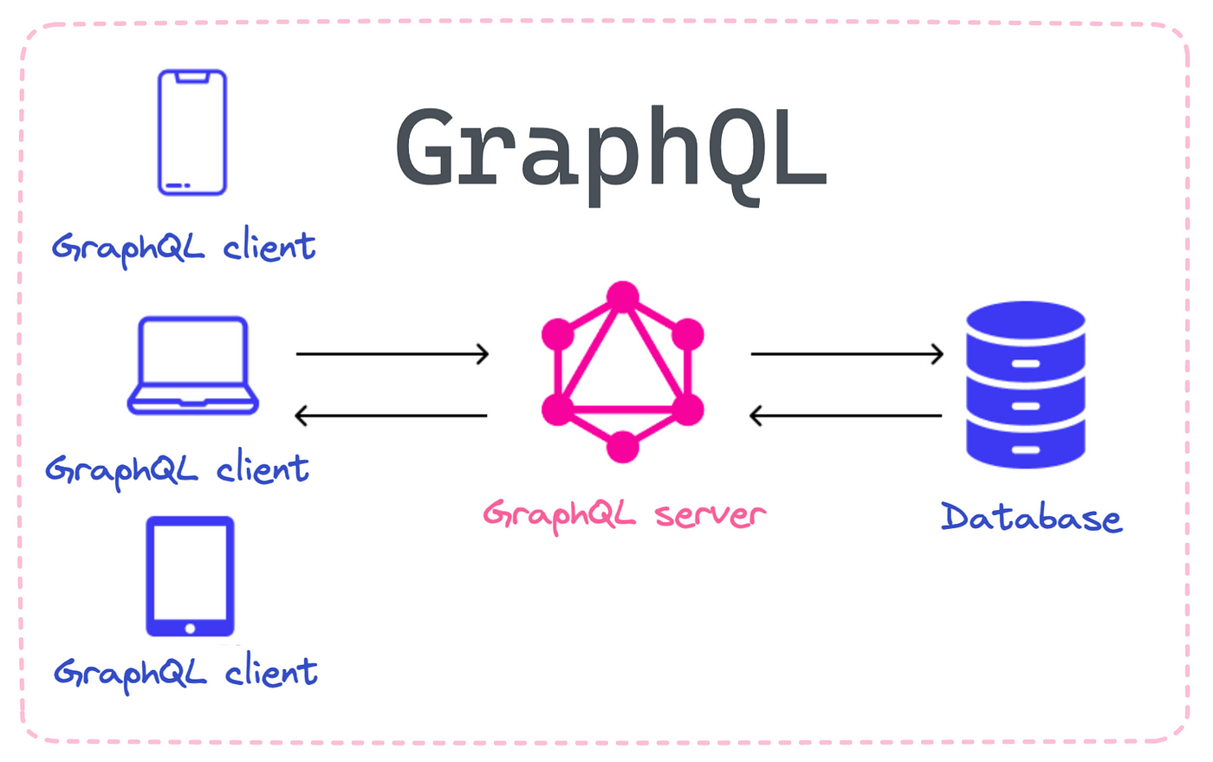
GRAPHQL APPLICATION STRUCTURE
Let’s understand the architecture of graphql from basic to complex structure from below samples.
1) Basic Process flow diagram of an GraphQL application.

Slide 25
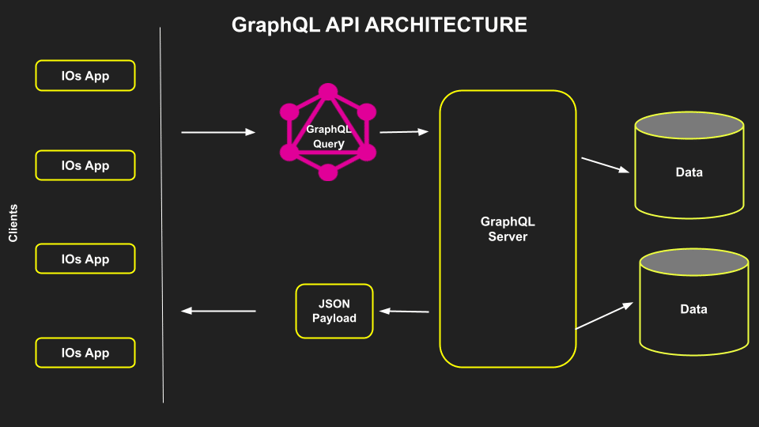
GRAPHQL APPLICATION STRUCTURE
2) Intermediate detailed Process flow diagram of an GraphQL application.

Slide 26
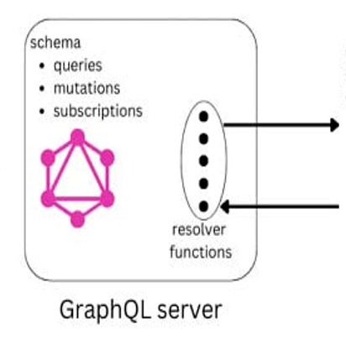
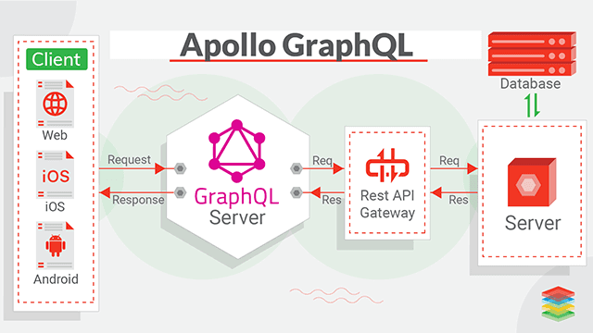
GRAPHQL APPLICATION STRUCTURE
3) Well Explained Process flow diagram of an GraphQL application.

Slide 27
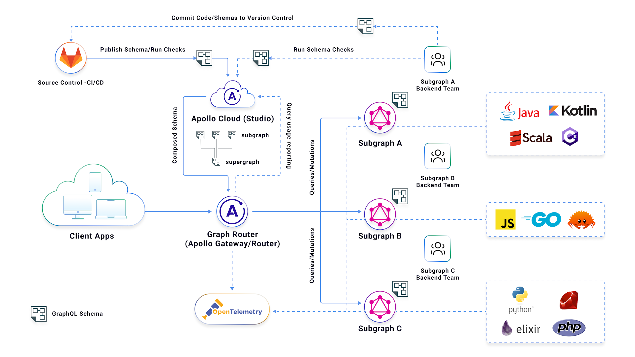
GRAPHQL APPLICATION STRUCTURE
4) Complex Process flow diagram of an GraphQL application.

Slide 28
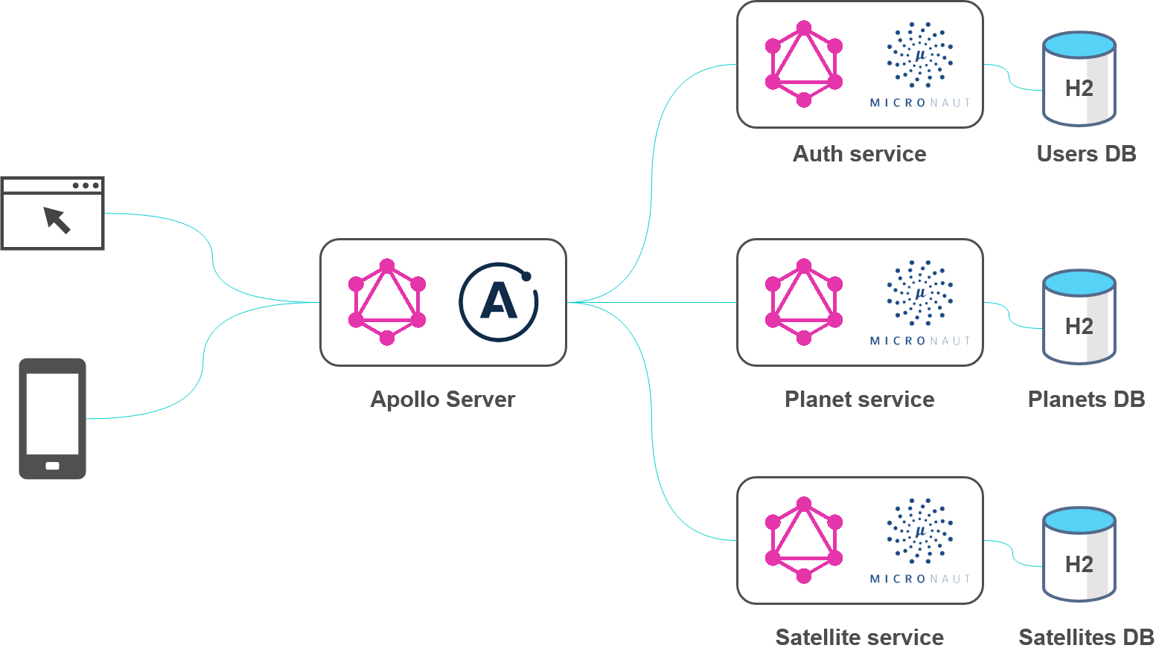
What is APPOLLO SERVER? Why?
Apollo Server is an open-source, spec-compliant GraphQL server that's compatible with any GraphQL client, including Apollo Client. It's the best way to build a production-ready, self-documenting GraphQL API that can use data from any source. pollo Server is a library that helps you connect a GraphQL schema to an HTTP server in Node. js. It’s possible to use Apollo Server with all popular HTTP servers like Express, Connect, Hapi, Koa, Restify, and Lambda.
Apollo Server provides:
Straightforward setup, so your client developers can start fetching data quickly
Incremental adoption, enabling you to add features as they're needed
Universal compatibility with any data source, any build tool, and any GraphQL client
Production readiness, enabling you to confidently run your graph in production

Slide 29
APPOLLO SERVER CONFIG STEPS
Below are the steps to define an Appollo server for GraphQL:
Installing Required Dependencies
Create Apollo Server
Define the typeDefs
Define the Resolvers
DONE

Slide 30
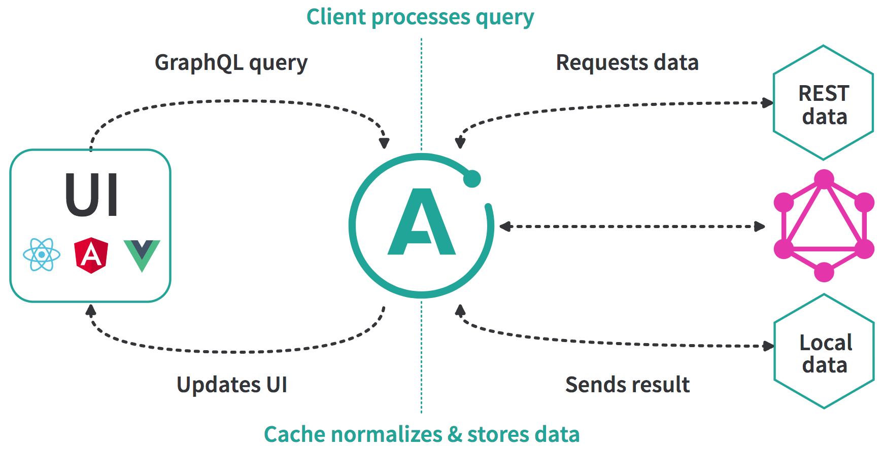
What is APPOLLO CLIENT? Why?
Apollo Client is a comprehensive state management library for JavaScript. It enables you to manage both local and remote data with GraphQL. Use it to fetch, cache, and modify application data, all while automatically updating your UI.
Apollo Client's intelligent caching can help you iterate faster while writing less code.
Additionally, if you need custom functionality, you can create your client by building extensions on top of Apollo Client.

Slide 31
TYPE SYSTEM IN GRAPHQL
GraphQL is a strongly typed language. Type System defines various data types that can be used in a GraphQL application. The type system helps to define the schema, which is a contract between client and server.

Slide 32
DATA TYPES in GRPAHQL
Scalar
Stores a single value
Object
Shows what kind of object can be fetched
Query
Entry point type to other specific types
Mutation
Entry point for data manipulation
Enum
Useful in a situation where you need the user to pick from a prescribed list of options
List
For Array of items
Non Nullable
Make sure the field returns something always

Slide 33
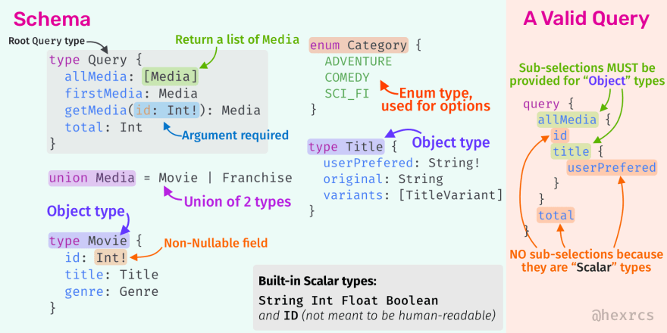
DATA TYPES – sample diagram

Slide 34
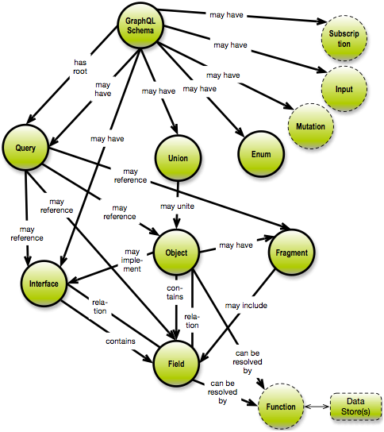
GRAPHQL – DATA GRAPH CONCEPT
It is a directed graph (of the concept map category)
Relationships are named
Relationships may be:
One-to-one
One-to-many
Many-to-many

Slide 35
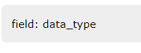
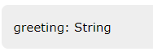
DATA TYPE- SCALAR
Scalar types are primitive data types that can store only a single value
Int − Signed 32-bit Integer
Float − Signed double precision floating point value
String − UTF - 8-character sequence
Boolean − True or false
ID − A unique identifier, often used as a unique identifier to fetch an object or as the key for a cache.
SAMPLE
SYNTAX

Slide 36
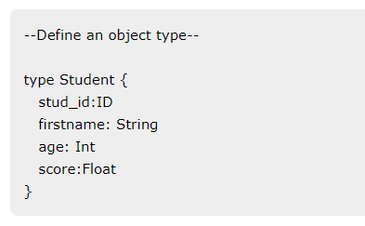
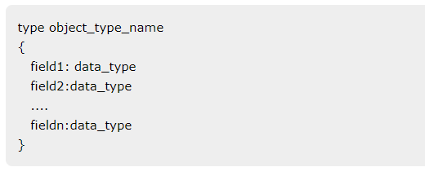
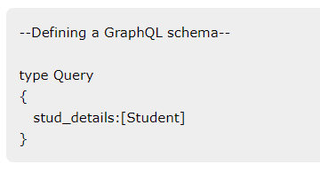
DATA TYPE- Object
The object type is the most common type used in a schema and represents a group of fields. Each field inside an object type maps to another type, thereby allowing nested types. In other words, an object type is composed of multiple scalar types or object types.
SYNTAX
SAMPLE

Slide 37
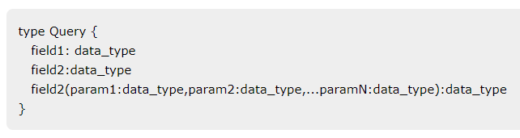
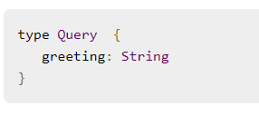
DATA TYPE- QUERY
A GraphQL query is used to fetch data. It is like requesting a resource in REST-based APIs. The Query type is the request sent from a client application to the GraphQL server. GraphQL uses the Schema Definition Language (SDL) to define a Query. Query type is one of the many root-level types in GraphQL
SYNTAX
SAMPLE

Slide 38
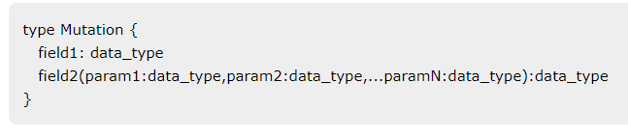
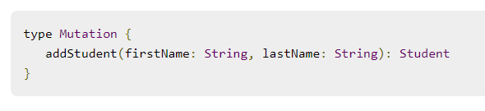
DATA TYPE- MUTATION
Mutations are operations sent to the server to create, update or delete data. These are analogous to the PUT, POST, PATCH and DELETE verbs to call REST-based APIs.
Mutation is one of the root-level data-types in GraphQL. The Query type defines the entry-points for data-fetching operations whereas the Mutation type specifies the entry points for data-manipulation operations.
SYNTAX
SAMPLE

Slide 39
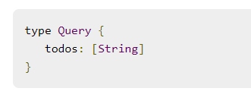
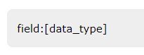
DATA TYPE- LIST
Lists can be used to represent an array of values of specific type. Lists are defined with a type modifier [] that wraps object types, scalars, and enums.
SYNTAX
SAMPLE

Slide 40
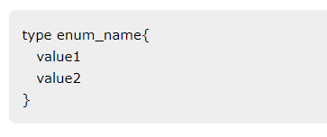
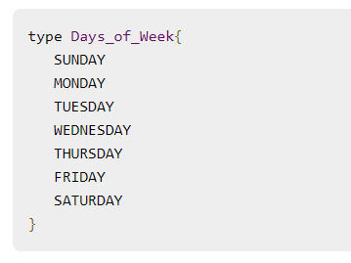
DATA TYPE- ENUM
An Enum is similar to a scalar type. Enums are useful in a situation where the value for a field must be from a prescribed list of options.
SYNTAX
SAMPLE

Slide 41
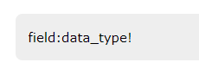
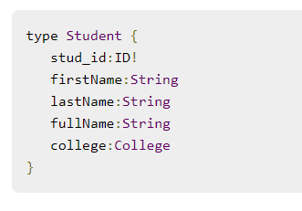
DATA TYPE- NON NULLABLE
By default, each of the core scalar types can be set to null. In other words, these types can either return a value of the specified type or they can have no value. To override this default and specify that a field must be defined, an exclamation mark (!) can be appended to a type. This ensures the presence of value in results returned by the query.
SYNTAX
SAMPLE

Slide 42
SCHEMA

Slide 43
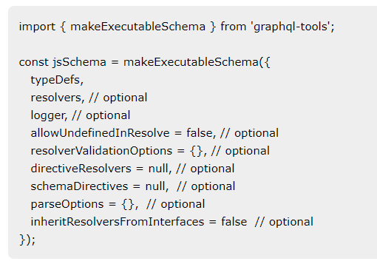
SCHEMA in graphql
A GraphQL schema is at the core of any GraphQL server implementation. It describes the functionality available to the client applications that connect to it. We can use any programming language to create a GraphQL schema and build an interface around it.
The GraphQL runtime defines a generic graph-based schema to publish the capabilities of the data service it represents. Client applications can query the schema within its capabilities. This approach decouples clients from servers and allows both to evolve and scale independently.
For the session, we use “Apollo server” to execute GraphQL queries and “graphql-tools” package to define the schema (makeExecutableShema Function)
Represents the query
Function that handles the query

Slide 44
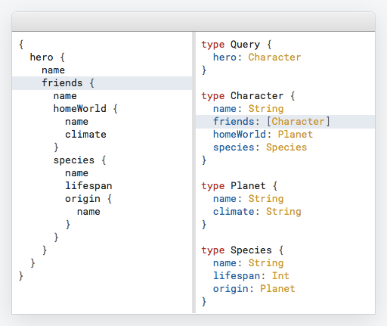
SAMPLE SCHEMA in graphql
Part of GraphQL
Schema
Query towards
the API

Slide 45
RESOLVER
FUNCTIONS

Slide 46
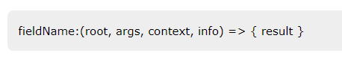
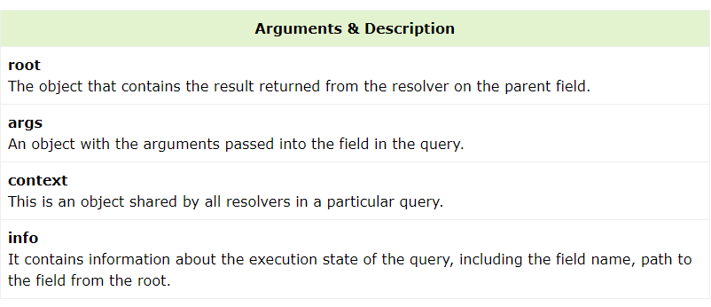
RESOLVERs in graphql
Resolver is a collection of functions that generate response for a GraphQL query. In simple terms, a resolver acts as a GraphQL query handler.
Every resolver function in a GraphQL schema accepts four positional arguments as given below :

Slide 47
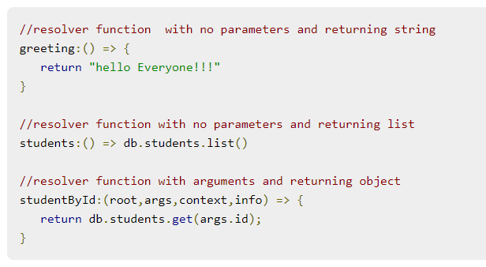
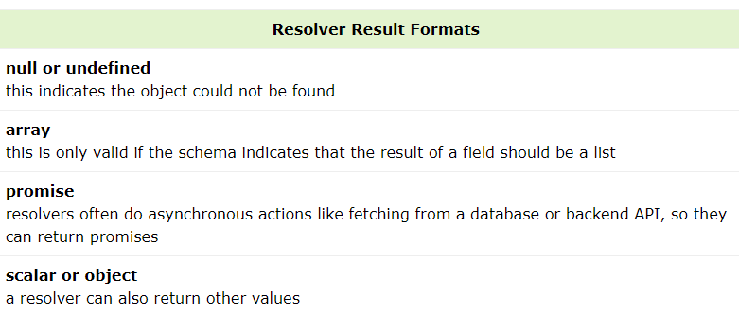
SAMPLE RESOLVER functions

Slide 48
QUERY

Slide 49


QUERY in graphql
A GraphQL operation can either be a read or a write operation. A GraphQL query is used to read or fetch values while a mutation is used to write or post values. In either case, the operation is a simple string that a GraphQL server can parse and respond to with data in a specific format. The popular response format that is usually used for mobile and web applications is JSON.
GraphQL queries help to reduce over fetching of data. Unlike a Restful API, GraphQL allows a user to restrict fields that should be fetched from the server. This means smaller queries and lesser traffic over the network; which in turn reduces the response time.

Slide 50
NEXT SESSION SETUP AND SAMPLE CODING REACT WORKOUT WITH GRAPHQL DO IT YOUR SELF

Slide 51
SETTING UP THE
ENVIRONMENT

Slide 52

STEPS TO SETUP GRAPHQL
In order to setup a sample Graphql server and query the data to see some results, lets follow below steps:
Create a Project folder and install required dependencies
Create a Backend Server using Express for routing and node server
Define the schema and resolver for graphql
Define routes to fetch data from front end (React/ GraphIQL)
Run the program & Test the GraphQl API using browser
Finish
DEPENDENCIES
To Run the GraphQL server
To define routing and node server
Graphql itself
Graphql helper library for making schema

Slide 53



SETUP
Create a Project folder and install required dependencies
Create a folder for the project in your local drive
Make sure you have installed nodejs and npm by running commands in the terminal (pic1)
node –v
npm -v
Get inside and create a file as “package.json”
Define the “package.json” as shown(pic2).
Open the terminal in the project root folder and add below commands as below to install the dependencies
npm install --save graphql graphql-tools apollo-server-express express
Once the installations are done, the “package.json” should look like below.(Pic3)
pic1
{
"name": "sample-graphql",
"private": true,
"dependencies": {
"apollo-server-express": "^1.4.0",
"express": "^4.16.3",
"graphql": "^0.13.2",
"graphql-tools": "^3.1.1"
}
}
pic2
pic3

Slide 54


SETUP
2. Create a Backend Server using Express for routing and node server
Create a file named “server.js” in the root add code as below.(pic1).
Run the command “node server.js” in the terminal
Open the browser and hit the URL http://localhost:4000.(pic2)
Pic2
Pic1

Slide 55

SETUP
3. Define the schema and resolver for graphql.

Slide 56

SETUP
4 . Define routes to fetch data from front end (React/ GraphIQL)

Slide 57


SETUP
5. Run the program & Test the GraphQl API using browser
Run the command “node server.js” again in the terminal and open the browser with URL http://localhost:4000“

Slide 58

SETUP
Entire code

Slide 59
NEXT SESSION DO IT YOUR SELF

Slide 60
DO IT YOUR SELF
Create a react application with React as front end and nodejs as backend with Apollo-graphql-server as grpaphql server. Then configure the graphql as below:
Define a sample array of object as student data source for each student with properties as below (sample json has been provided in the last slide):
Id:Int
email:String
firstName: String
lastName: String
Define the graphql configuration that it returns an array of Student objects when requested.
With the backend nodejs, define routes that serve the graphql access points (“/graphql”).
In the front end, there should be a button named “Fetch all Students”. On clicking on this button, student data should be fetched from the Backend and displayed as a list in the UI as below
Student Name: firstName+lastName
Student Id: id
Email: email

Slide 61
DO IT YOUR SELF
Sample JSON
[
{
"id": "S1001",
"email":”mohtasim@sample.org”,
"firstName": "Mohtashim",
"lastName": "Mohammad", },
{
"id": "S1002",
"email": "kannan@sample.org",
"firstName": "Kannan",
"lastName": "Sudhakaran
},
{
"id": "S1003",
"email": "kiran@sample.org",
"firstName": "Kiran",
"lastName": "john“
},
{
"id": "S1004",
"email": "kiran@sample.org",
"firstName": "Tim",
"lastName": "George“
}
]

Slide 62
THANK YOU
Noufal Puthenpeedikayil

